Slide 1
Database Management Systems
Term Project
DBMS22
Paulina, Shweta, Rutuja & Utsav

Slide 2
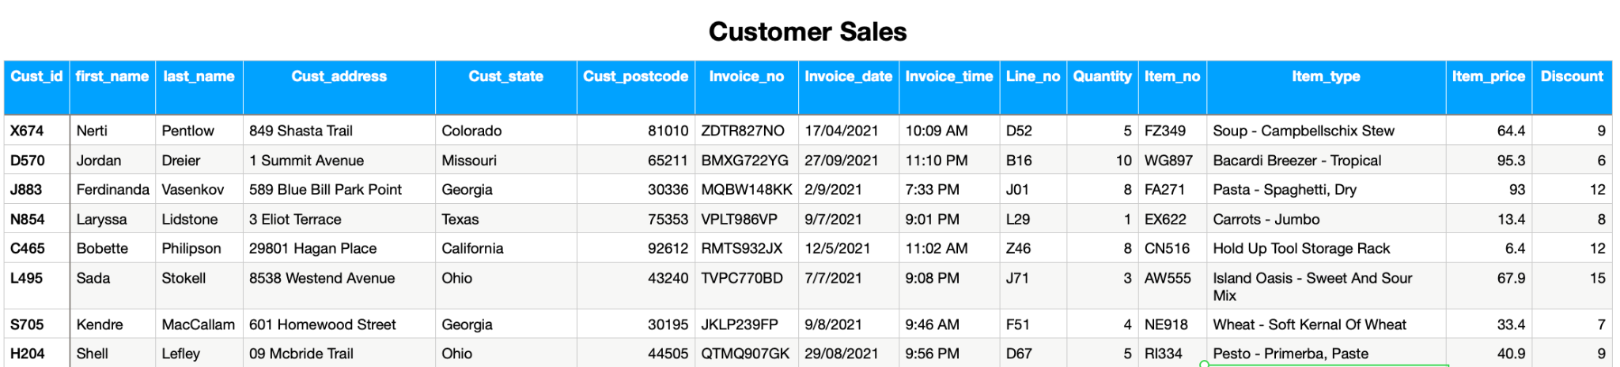
Our Dataset & Tables
We have used a sales dataset which is a culmination of data from some kaggle datasets and mock data generator “Mockaroo”
The dataset consists of 15 columns describing the customer details, item details and invoice details
We have 5 tables that we created from the raw csv: consist, customer, invoice, invoice item & item
We have 5 pk namely: 5th one is a combination of 2 fk

Slide 3
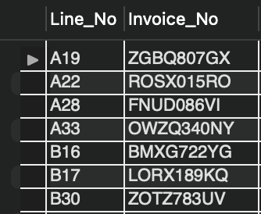
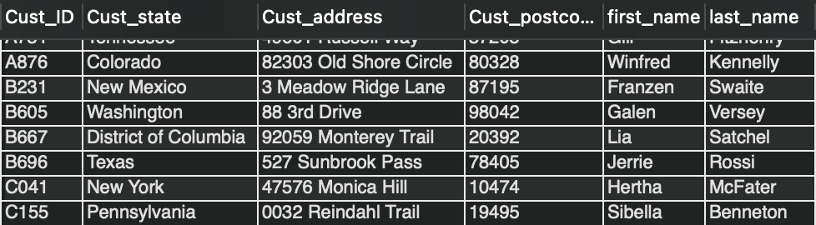
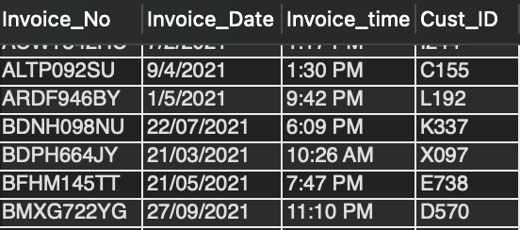
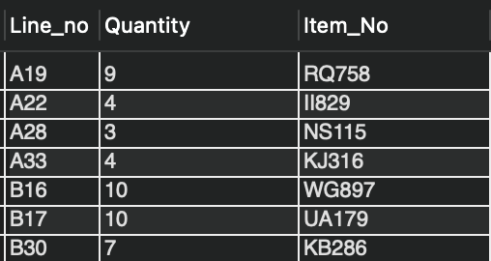
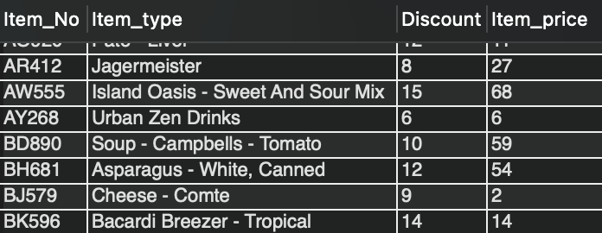
Tables that were created
Consist Table - Operational DB
Customer - Operational DB
Invoice Table - Operational DB
Invoice Item Table - Operational DB
Item Table - Operational DB

Slide 4
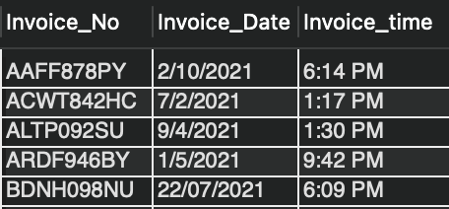
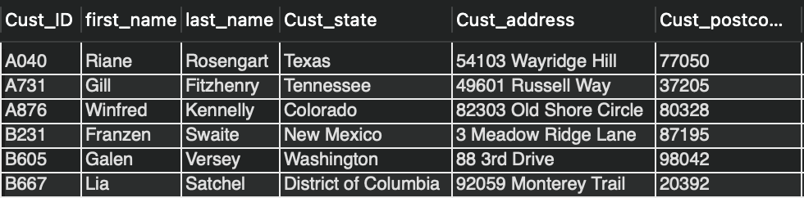
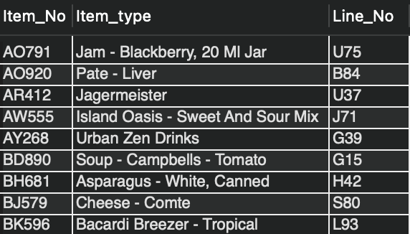
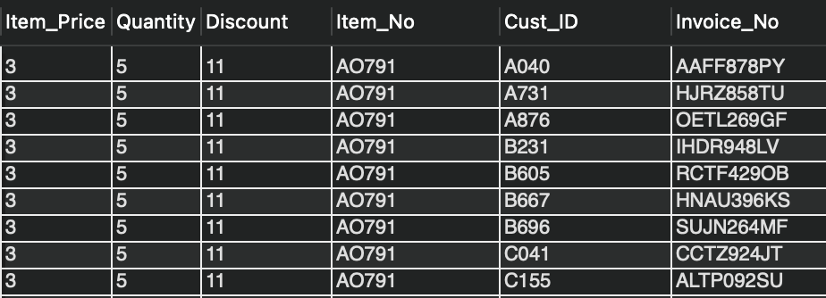
Tables that were created - Analytical DB
Calendar dim - Analytical DB
Customer dim - Analytical DB
Item dim - Analytical DB
Sales Fact Table - Analytical DB

Slide 5


Our Application
The purpose of our application is to provide small business with tools to track their sales transactions as well as offer these businesses the option to create rewards programs for their customers as it captures customer data

Slide 6
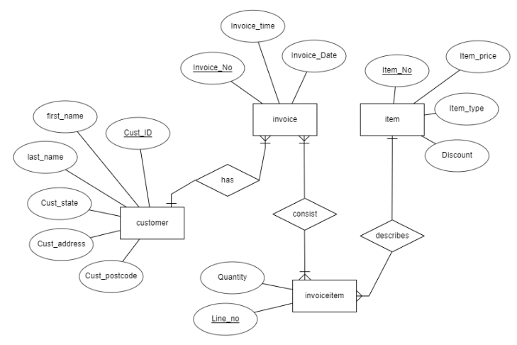
Entity Relation Diagram
ER diagram is needed to understand the tables and their relationships with each other which can be in 3 different forms, 1:1, 1:M and M:M

Slide 7
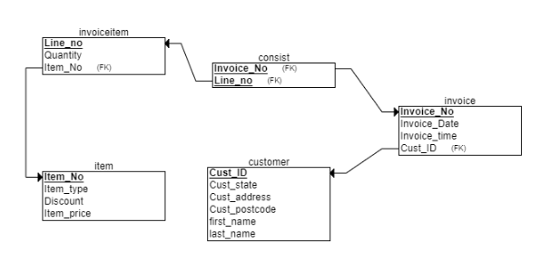
Relational
Schema
Our relational schema shows the relationship between the different tables we have created and the foreign keys that are present in each table.

Slide 8
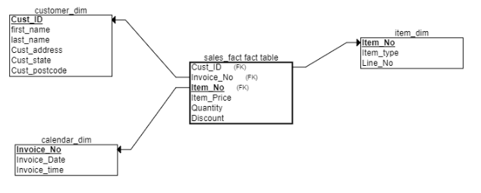
Star
Schema
Our Star Schema shows the relationship between our sales fact table and the rest of the tables that were created on our analytical database

Slide 9
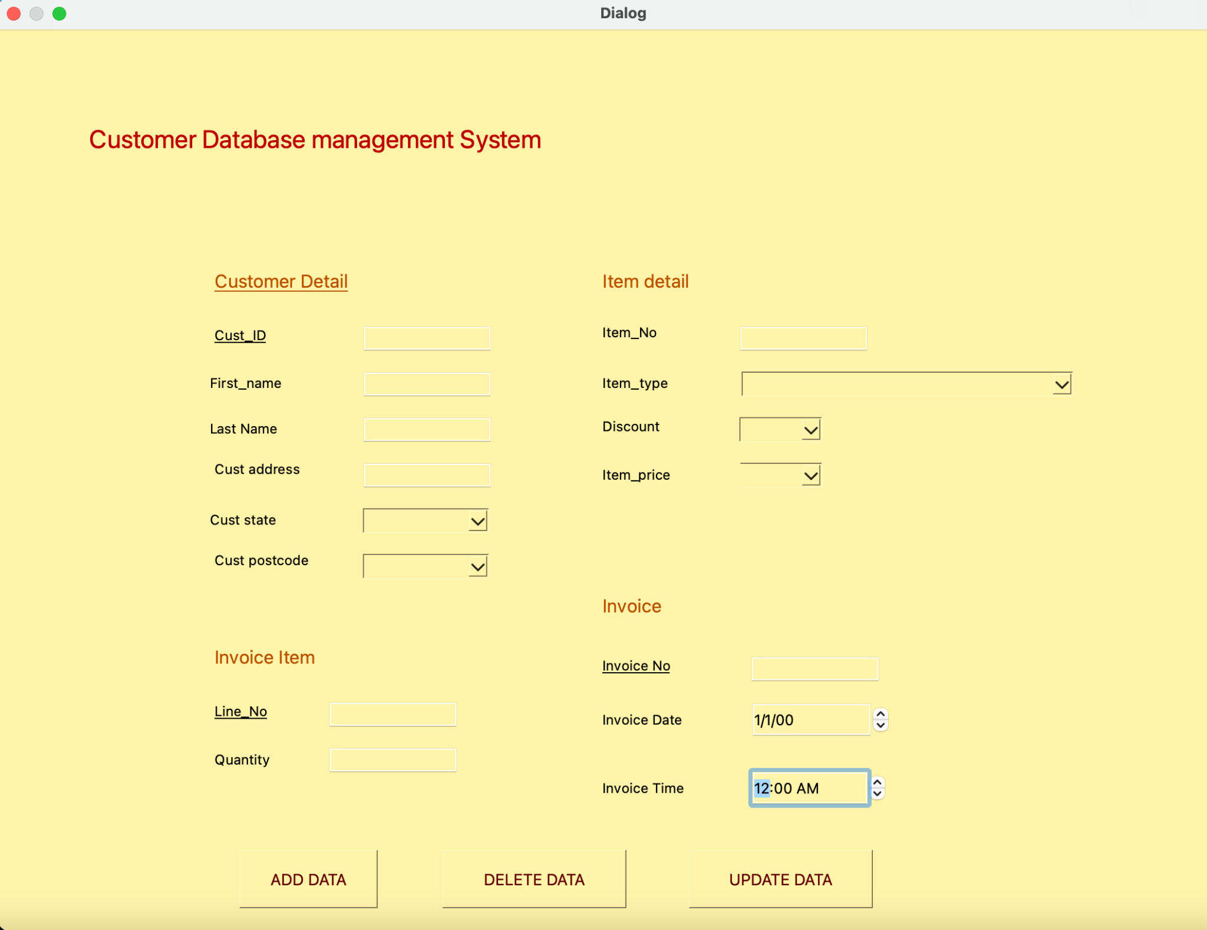
OPERATIONAL GUI
We will now present a demo of our project

Slide 10
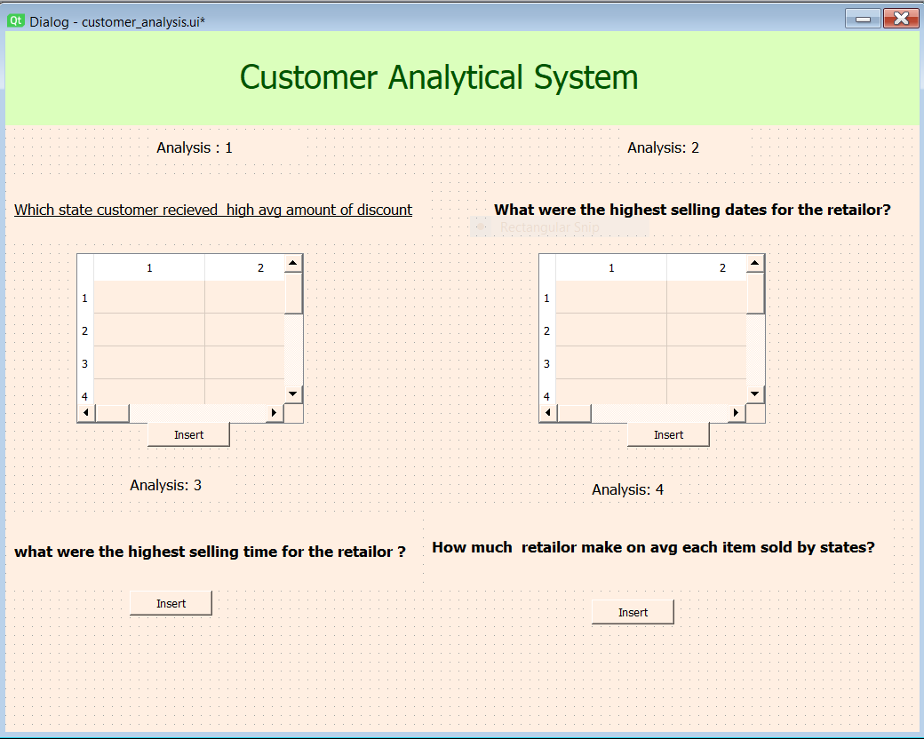
ANALYTICAL GUI
We will now present a demo of our project

Slide 11
THANKS!
Any questions?

